Slide 1

CAPSTONE PROJECT REVIEW I Title of the Project
Name : Tushar Maurya
Register No:19BCE1856
Programme & Specialization : B.Tech CSE
Guide Name:
Dr. K. Sathyarajasekaran

Slide 2
Outline
Introduction
Literature Review (15 Latest Papers – Minimum - from Reputed Journals/Conferences)
Research Gap
Problem Statement
Research Motivation
Research Challenges
Research Objective
What is to be done next (1 Slide)
Research Paper Status
Guide Approval mail snapshot
References

Slide 3
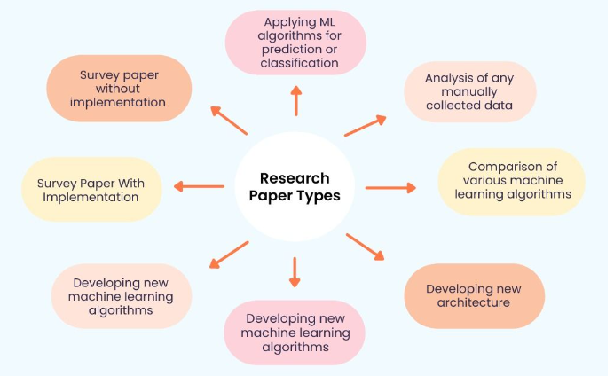

Slide 4
Introduction(Max 2 slides)
Businesses around the world are evolving every day which has drastically led to the growth of two major fields Artificial intelligence and Machine Learning.
Technology based on AI and ML has recently developed to such an extent that it has become an essential element of the largest online stores on the web.
Most of the work in the online store is automized.

Slide 5
Other fields where ML and AI have achieved excellence:-
Speech recognition(Voice search, appliance control, Alexa Home, Google Home)
Virtual Assistant(Alexa, Siri)
Image recognition(facial, non-living things)
Google Translation(Language translation)
Traffic Alerts in Google Maps
Self-driving cars(Waymo)
Medical diagnosis
Predictive analytics(Loan prediction, SIP amount prediction)
Recommender System(Music and movie Recommendations)

Slide 6
Background Work, Challenges ( Max 3 to 4 Slides)
The main work behind the scene is the phase of learning because it’s true that AI and ML are very vast topics.
So every day, I am learning new algorithms and focusing on building better practical models, and learning how to optimize the model in a better way because I felt in most cases the model is already prepared its about the space that is so large or the accuracy that is so bad.
I also faced issues while studying and selecting the correct material for different topics as most of the courses were either highly paid or the courses on youtube aren’t reliable.

Slide 7
The main challenge was selecting the final idea as the field is evolving at its peak because of the tech giants like Amazon, Alibaba, Flipkart, and Walmart.
Every day I read one article in the morning since I enrolled in the capstone project as working on this idea as my final project was one of my dreams when I joined the college due to the placements I was not very regular but still I was able to make ends meet.
The Research paper was not a difficult part as I was getting the idea of how to implement it by reading so much in the right direction.

Slide 8
Literature Review/Survey ( Max 7 slides- 15 Latest Papers from journals & conferences) Each slide maximum of 2 to 3 papers
S.No | Paper Title (APA Format) | Summary | Algorithms Used | Pros / Cons
[1] | Jordan, M. I., & Mitchell, T. M. (2015). Machine learning: Trends, perspectives, and prospects. Science, 349(6245), 255-260.
[2] | Shah, D., Patel, S., & Bharti, S. K. (2020). Heart disease prediction using machine learning techniques. SN Computer Science, 1(6), 1-6.

Slide 9
Literature Review [Conti..]
S.No | Paper Title (APA Format) | Summary | Algorithms Used | Pros / Cons
[1] | Jordan, M. I., & Mitchell, T. M. (2015). Machine learning: Trends, perspectives, and prospects. Science, 349(6245), 255-260.
[2] | Shah, D., Patel, S., & Bharti, S. K. (2020). Heart disease prediction using machine learning techniques. SN Computer Science, 1(6), 1-6.

Slide 10
Research Gap

Slide 11
Problem Statement

Slide 12
Research Motivation

Slide 13
Research Challenges

Slide 14
Research objectives

Slide 15
Work to be Completed(What is to do be done in Review 2)

Slide 16
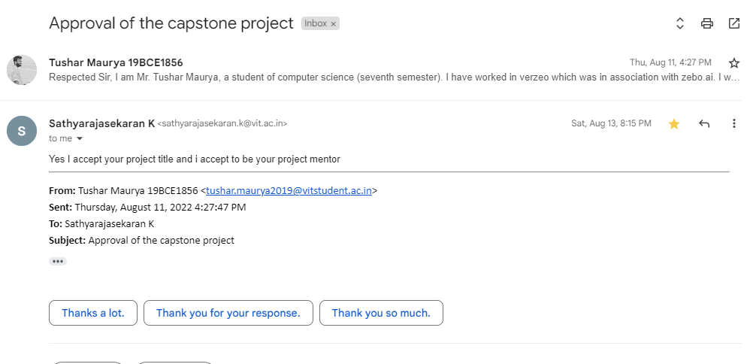
Guide Approval Snapshot

Slide 17
Any other additional information to be added by Guide
No, There is no additional information to be added by the Guide. My guide is very helpful, I already knew that as I studied TOC one of the toughest theoretical subjects under him and he helped me a lot even at that time. Even in the times of Covid-19, he delivered his best using a whiteboard at home. So, I thought to work under his supervision.
My idea was accepted after writing a mail to the guide and explaining everything on call.

Slide 18
References ( Same order as Literature Review)
[1] Jordan, M. I., & Mitchell, T. M. (2015). Machine learning: Trends, perspectives, and prospects. Science, 349(6245), 255-260.
[2] Shah, D., Patel, S., & Bharti, S. K. (2020). Heart disease prediction using machine learning techniques. SN Computer Science, 1(6), 1-6.

Slide 19
Thank You

